Slide 1
Handle with Care (HWC) Responder Team
JUNE 29, 2023
Notes:
Renee: Hello and welcome, thank you for being here today to learn about the great work being done in our State to provide trauma responsive care for youth in our communities. I am Renee Eldredge Heywood’s HWC Collaborative Liaison and HWC Responder team lead; we are a team of 8 members including: Christine Holmes, Tina Duguay and Carol Lynne Papa work in the Heywood Athol/Gardner EDs, Lt. John Czasnowski with GPD, Chief Jason Tamulen with WPD, Ally Law District Nurse for Ash/West school district and last but not least, Mike Ellis, also with Heywood Healthcare. On behalf of our team, we would like to thank Heywood Heathcare and CCWT for the opportunity to participate in this inaugural program. Handle with Care reinforces trauma-informed care practices for youth in our schools and law enforcement as first responders, encountering children at a traumatic event. The North Central / North Quabbin region has assisted in identifying hundreds of children with the need for trauma-informed care since 2019. The Handle with Care North Central / North Quabbin initiative has expanded from our current 6 school districts and 10 police departments to include Heywood Healthcare Emergency Room Registration Departments in Athol and Gardner. And now I would like to turn the presentation over to Mike Ellis our team spokesperson.

Slide 2
HWC Emergency Room Initiative
Initiative
Support trauma informed care with the use of a caregiver self-referral tool by informing schools, daycares, and/or physicians to offer trauma responsive care to the youth who have visited the emergency room.
To mitigate negative effects experienced by children’s exposure to a traumatic event.
.
Mission
Community
Greater Gardner area including North Central and North Quabbin Region.
Supporting youth 3 years to 18 years of age.
Notes:
Initiative and Mission come directly from our Strategic plan and coincide with our work which started with local law enforcement and now evolved into the healthcare sector. Mitigate the adverse/negative effects of Secondary Trauma/Indirect—

Slide 3
HWC Collaborative and Stakeholders
Youth and their Families
Heywood Healthcare, Gardner and Athol Hospital, Athol
6 Local area School Districts - Inclusive of Public, Private and Alternative Schools
10 Local area Police Departments and 3 DA Offices: Plymouth, Northeastern and Worcester Counties
Non-Profit Organizations
Community at Large
Notes:
Really intended and created to bring many diverse groups to the table to help foster trauma informed care where kids are.
Special thanks to the HWC Responder Team which includes members from a variety of sector including education, law enforcement, government, health care and the private sector working collaboratively to strengthen HWC through the ED initiative and become stronger trauma informed care leaders. It is important to note as well that historically, these partners have not had alot of opportunities to collaborate and integrate their resources to provide better care for our community. As a group, we have demonstrated we can have a greater impact when we are working together. As we look forward to our state-wide development of HWC it is going to be even more imperative to have the support of local and state legislators to champion the initiative in their regions.

Slide 4
Activities and Outcomes
Capacity Building
Community and hospital stakeholders engaged in a process and program assisting youth in need of trauma informed care visiting the Emergency Department (known as the Handle with Care Initiative or HWC).
Training
Reviewed, developed and disseminated HWC materials, training and psycho-educational materials for cultural competence and trauma responsive awareness.
Marketing
Identified social media and other media modalities/platforms to promote HWC awareness.
Reporting & Analytics
Tracked and reviewed data and reflected on successes.
Notes:
The things we really focused on include but are not limited to:
Capacity Building: Systems approach to ensure we capture anyone who may be eligible for participation in this aspect of HWC which includes developing process and policies, implementing technology and electronic record keeping as well as notification linkages between health care systems, first responders, and school systems
Training: Lots of training components including trauma informed care and trauma informed responsiveness, adverse childhood experiences, training for staff on using and accessing the referral tool, and cultural competency including access to translation services.
Marketing: Distributing HWC materials to law enforcement, parents, health care workers and community at large that describe the initiative and provide information on how to access additional information about HWC, community awareness events and activities including focus on health care workers and the health care system. The self referral tool and website create the foundation for our next steps to further involve and engage private practice groups.
Reporting: As of May 31, 2023 over 800 patients/caregivers were provided HWC information and invited to use the HWC Self Referral Tool. This review helps us see how and why caregivers are accessing HWC and supports plans for further development to meet the needs of our youth. For example, our review of data has allowed us to determine that almost 10% of the youth accessing emergency room services and who were offered HWC information have mental health or substance use emergency room diagnosis giving us the ability to advocate for expanding our linkages to telehealth services in the school districts participating in HWC for this population.

Slide 5
Celebrating Our Wins: Continued Collaborative Efforts
Partnered with stakeholders to expand HWC through a new statewide HWC initiative.
Increased understanding of and implementation of Trauma Informed Care (TIC) among partner organizations including healthcare, police first responders and schools.
Increased trauma responsiveness for the youth at school and in the community.
Increase participation with existing school based tele-behavioral health services for behavioral health and/or substance use disorder needs.
Notes:
Heywood HWC is now working with different District Attorneys Offices, law enforcement agencies, schools and health care providers to introduce and implement HWC in the Region.
To make all this work, we need to make sure that all of our partners who interact with youth who have experienced trauma are trained in and able to provide appropriate trauma informed care in their respective environments. To that end, we have been focused on training, including, for example, a remarkable training on Adverse CHildhood Experience, and the long term and short term physiological responses to trauma.. This allows for a greater likelihood that our partners are able to provide this trauma informed care when needed. Frankly, it’s all about knowing. When we know better, we do better. Knowing when a youth has experienced a traumatic event certainly allows us to provide the care needed for the youth.
Which brings us to the last point…what better result than to be able to identify a youth who needs mental health or substance use support and be able to link them immediately to services. By including the tele-health program already existing in our districts we can advance the long term positive health interventions for the youth we serve.

Slide 6
Celebrating our wins: Community Engagement
Enhanced and diversified awareness about trauma responsive care for youth among our community partner organizations and agencies.
Provided stakeholders with TIC training and TIC resources: quarterly meetings and newsletter, and a website.
Heywood’s HWC website: www.heywood.org/handlewithcare
Increased related trainings from partner organizations including but not limited to LUK, PPAL, Center on Child Wellbeing & Trauma that strengthened trauma informed care skill sets.
Notes:
Today is a great example of the community engagement successes of the HWC initiative. By virtue of our being able to share today at the Center for Child Wellbeing and Trauma all the work we do, we are able to increase awareness among many leaders in a whole host of communities dedicated to to the idea of increasing and improving care for our target populations. Similarly, on a more micro level, we have been able to move the needle on understanding trauma and appropriate ways to engage with youth who have experienced trauma. Training, resources, information, awareness, and collaborations make our impact on youth bigger, more effective, and more sustainable.

Slide 7
Celebrating Our Wins: Outcome Objectives
As of June 2023 Heywood Healthcare Athol / Gardner and HWC Team have provided:
100% of ED Registration Staff HWC training.
100% of HWC police departments and school districts are knowledgeable in the ED referral best practices.
All patient caregivers have been provided HWC self-referral forms since inception.
Increased awareness with Hospital Administration and HWC Collaborative for behavioral health (BH) and substance use disorder (SUD) prevalence among youth.
Notes:
So what has happened since March 20 well, it is remarkable to note that we have been able to provide the information about the HWC self referral tool to 100% of the caregivers of youth between ages 3 and 18 who have come into our ED. 100% of the ED registration staff have been trained on providing the self referral tool. We have trained 100% of the participating police departments and 100% of the participating school districts on HWC and the ED referral practices. Our outreach and training aspects of this initiative have allowed us the opportunity to better educate and inform providers on the most prevalent trends for youth who visit the emergency room including but not limited to mental health and substance use concerns giving us a springboard to create effective and meaningful interventions both upstream and downstream.

Slide 8
Celebrating Our Wins: Quotes From Stakeholders
“The more places we can identify trauma, the more equipped we are to handle it. We are grateful to be part of this community’s effort. Collaboration is a force multiplier. From police departments and school districts to hospitals and the justice system the work and commitment to trauma reduction have created a child-first model prioritizing and supporting all areas of care to ensure kids feel safe and secure. This is such an important program because children are 20% of our population but 100% of our future.”
~District Attorney Joe Early Jr, Worcester County
“Handle with Care has been a great program for us. In education, we try our best to use trauma-informed practices daily with our students. HWC is a tangible reminder that alerts us of students and families going through difficult situations. In turn, the program continually underscores the necessity of using trauma informed practices each and every day and keeps us from losing our awareness of the unique emotional needs and support of students that we could otherwise overlook.”
~ Ashburnham/Westminster School Administrator
“Handle With Care" provides a voice for our youth when they need it most.”
~ Dawn Casavant, VP Heywood Healthcare Administration
“We are excited about the new opportunities that allows our departments to collaborate in deeper and more effective ways to support our students and families and help them thrive and be successful.”
~Local Law Enforcement
Notes:
So – have we had a real impact?
Here is what some of the people who have been involved in handle with care say.
HWC provides a voice for youth when they need it most
HWC creates deeper and more effective ways to support students
HWC is a tangible reminder of students and families going through difficult situations and apply TIC in these situations
HWC creates a child-first model prioritizing and supporting all areas of care to ensure kids feel safe and secure

Slide 9
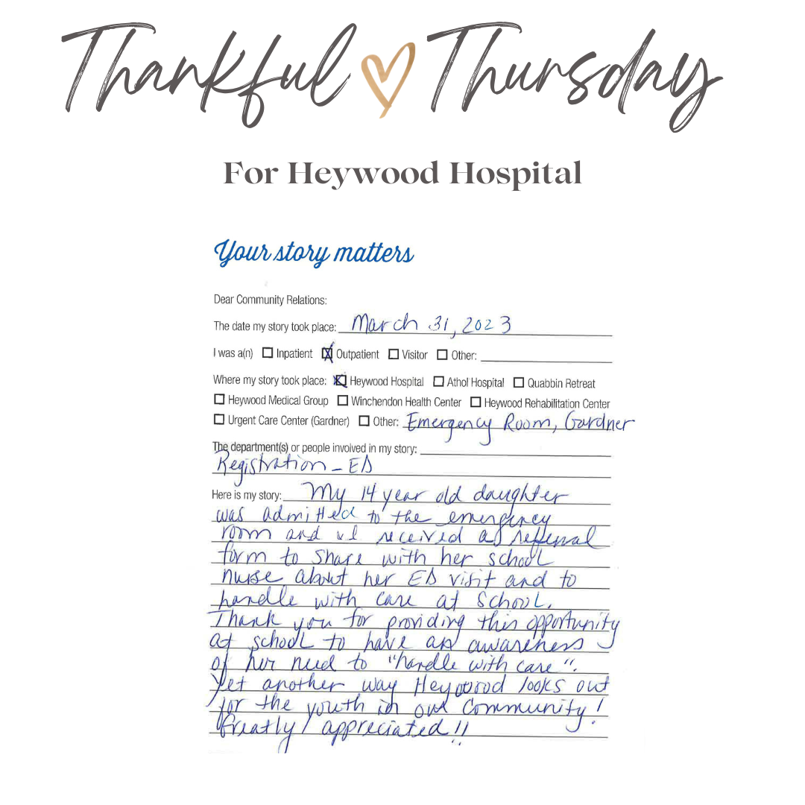
Celebrating Our Wins: Patient Feedback
Notes:
A note Heywood received from a caregiver after their child was registered and seen in the Gardner emergency department. Another way we look out for youth in our community.

Slide 10
3 Positive Impacts from CART Program
3 key take-aways from CART Learning Sessions & CART Coaching Sessions
CART provides a structured environment to develop and implement deliverables for new initiative.
We have embraced the importance of respecting translation skills afforded an organization that serve a diverse population.
We provide organizations with a view through a trauma responsive lens to embrace, learn and deliver trauma informed care to youth in the communities we serve.
Notes:
This work we have done through CART really provided a great framework to identify, create and then implement deliverables that enhance our work with youth. The strategic planning process gave us the opportunity to look at our work not only for the last six months but build the foundation for our work going forward. Certainly, CART has allowed the opportunity to see things in ways we might not otherwise have imagined, and to that end provide a different approach to developing and implementing solutions, including for example understanding and eliminating barriers around language and culture. The training our leadership team received has been put into practice and shared among our stakeholders to enhance trauma informed care in our region.Resources available in the network and the Center have been invaluable and provided a gateway to expand the impact of handle with care well beyond our established service area. Finally, we have been able to develop meaningful metrics to see and understand the impact of the HWC initiative as well as identifying critical health care needs of our youth.

Slide 11
3 Positive Impacts from CART Program
3 key take-aways from CART Learning Sessions & CART Coaching Sessions
ADDITIONALLY:
The ability to continue networking with the Center and Positive Adverse Childhood Experiences (PACES) after graduating the program.
An opportunity to continue relationships with the cohort organizations in the State which provide trauma responsive care.
Use of tracking tools to maintain and strengthen outreach efforts.

Slide 12
Sustainability & Growth
Heywood Healthcare is supporting the development and implementation of future Phases of HWC, including utilizing a direct HWC referral reporting system to the school nurse with use of QR code for school districts within the HWC collaborative.
Engaged in ongoing partnerships with West Virginia’s Handle with Care initiative and 3 local District Attorney offices to grow the initiative statewide for first responder police departments.
Increased participation and continue to expand HWC in both traditional and non-traditional settings.
How Can You Make a Difference In Your Community:
Provide systemic ongoing trauma responsive training within your organizations and all community partners.
Please visit Heywood’s HWC website for resources and contact information: www.heywood.org/handlewithcare
Notes:
Lots of moving parts for HWC
First, expanding HWC locally includes bringing into the fold more local school districts, more police departments, and more health care providers. Each phase we implement has increased our capacity to deliver effective and meaningful training, processes and partnerships. But there is more, HWC has traction and that is allowing us the opportunity to expand HWC to partnerships in other areas of our state and expanding the our own base and support of the HWC initiative to both traditional and non-traditional partners from our community.

